Slide 1



SUN POOL MANAGER(SPM) Addressing Today’s challenges With Tomorrow’s Technologies
By : Anas Alseid

Slide 2
Introduction
Embarking on a transformative journey, the "Sun Pool Manager" initiative pioneers a smart revolution in swimming pool maintenance, harnessing the synergy of the Internet of Things (IoT) and the renewable vigor of solar energy.
The project aims to tackle the challenges of conventional pool management systems, including high maintenance costs, energy consumption, and environmental impact.

Slide 3
System Overview
Current pool maintenance and energy management systems are plagued with inefficiencies, high operational costs, and significant environmental impacts. The reliance on manual labor, chemical treatments, and non-renewable energy sources highlights the urgent need for smarter, sustainable solutions.

Slide 4
Smart Pool and Smart Solar Systems: A Dual Approach
Introducing our innovative solutions: the Smart Pool System for automated, chemical-efficient pool maintenance, and the Smart Solar System for optimized solar energy production and usage. Together, they represent a comprehensive approach to reducing energy consumption, operational costs, and environmental footprint.

Slide 5
Technical Innovations
At the heart of our systems are IoT sensors and AI algorithms, enabling real-time monitoring and predictive maintenance. Our user-friendly app provides seamless control and monitoring, ensuring optimal performance and user experience.

Slide 6
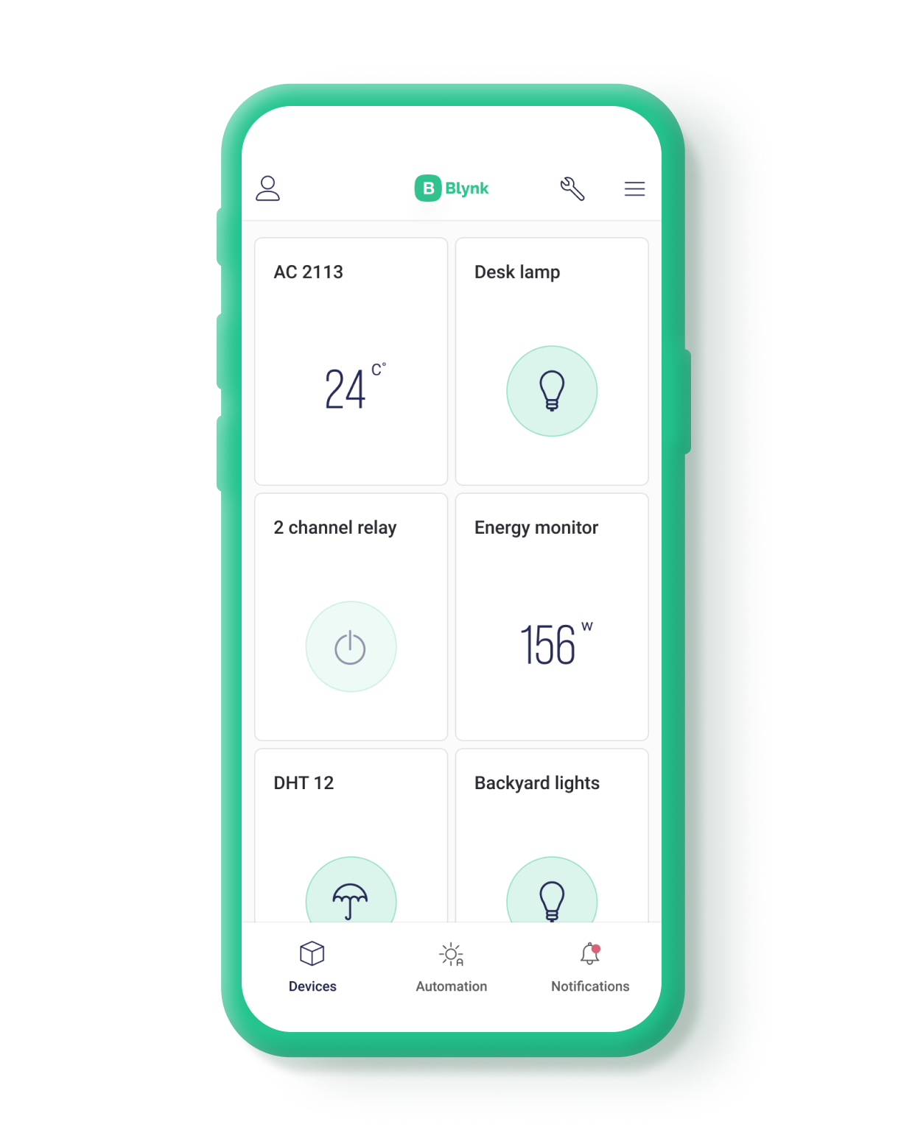
Blynk integration:
We are using Blynk to get notified on the phone , if there’s any problem with the water levels or pH and chlorine levels.
Also, to detect if there’s any objects gets in the pool while managing the water level, pH, and chlorine.
If there’s a change in the production of the solar panels a notification will be sent to Blynk.

Slide 7
Economic Feasibility
Our economic feasibility study outlines the initial investment, detailed cost analysis, operational savings, and revenue projections. It demonstrates our project's financial sustainability and market competitiveness.

Slide 8
Cost Breakdown Per Unit
"Material Costs: $105 - Including sensors, controllers, and miscellaneous components for both systems."
"Manufacturing & Assembly: $20 - Streamlined processes for cost-efficient production."
"Software Licensing & Development: $5 - Amortized software development costs."
"Testing & QA: $5 - Ensuring product reliability and user satisfaction."
"Packaging: $2 - Eco-friendly and secure packaging."
"Certifications: $10 - Compliance with industry standards."
"Overheads: $20 - Indirect costs covering facility operations and administrative expenses."
"Total: $167 per unit, providing a solid foundation for competitive pricing."

Slide 9
Production Costs for 500 Units
For our initial production run of 500 units, the total investment is $83,500. This investment covers comprehensive development costs, from manufacturing to market readiness, positioning us for a successful launch

Slide 10
Future Work: Proprietary App Development & AI Integration
App Development: Launching a proprietary app for Smart Pool and Smart Solar Systems to slash operational costs and enhance user interface. Expect real-time monitoring, instant alerts, and tailored settings—all user-friendly.
AI Integration: Implementing AI to elevate efficiency and reduce expenses. It'll analyze energy use and weather, adjusting systems proactively. Expect smarter maintenance, prolonged equipment life, and insightful data for better decision-making.

Slide 11
Q&A
Thank you for your attention and interest in our Smart Pool and Smart Solar Systems project. We're now open to any questions you may have. Whether you're curious about technical details, financial aspects, or potential collaboration opportunities, we're here to provide answers and discuss how we can work together to make sustainable facility management a reality.

